Slide 1

Towards A Full Service Hospital in Nanaimo – Update
Focus on Cardiac Services
Nanaimo Medical Staff Association (MSA) Presentation To:
Nanaimo & District Hospital Foundation

Slide 2
Full Service Hospital For CI/NI in Nanaimo
Programs/Funding have not matched the Medical Need and Population Growth in CI/NI over the last 15-20 years.
Historical processes have not addressed this.
Recognized by IH Administration/IH Board - 2017 - working with Local Health Care Providers - 5 Yr. Priority Services Development Plan
Identified all Services, including Tertiary Services needed - for all CI/NI.

Slide 3
The Need for a Full Service Hospital is Simply due to Population and Demographics
BC Government Estimates 2021:
  Population ~ 450,000 + in the CI/NI and 439,000 in the SI below the Malahat
  Oldest population in Canada in CI
  Growing faster in CI/NI
  Complexity of patients is the same. We have Tertiary Patients!
  Busiest ER on VI by far at NRGH
  Serve many vulnerable populations, 80% of First Nations, who are often remote.
  Acute care demands will increase in CI/NI!

Slide 4
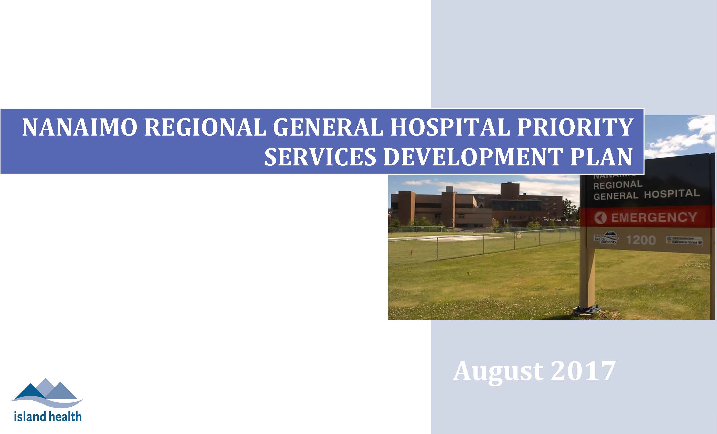
5 Year Plan for a Full Service Hospital for up Island

Slide 5
Top 10 Priorities from the 5 Year Services Plan – MSA/LMAC
  1. Improve Culture and Relationships with IH administration.
  2. More Appropriate Care for Critically Ill at NRGH. Access to General Internal Medicine and Medical Sub Specialist Programs – Recent progress. - Not in Cardiology.
  3. More appropriate Care for Pediatric & Adult Mental Health Patients – Recent progress.
  Meet Growing Demand for Cancer Care Services on VI. Promised by Premier! Letter.
  5. Improve Access to Existing Surgical Services/New Services/Wound Care.
  6. Expand Access to Rehabilitation Services at NRGH and Other Nearby Sites
  7. Better meet the needs of End of Life Patients
  8. Strengthen Supports for Patients who use Substances
  9. Increase Local Access to Renal Services and necessary supports
  10. Improve Timely Access to Proceduralists at NRGH

Slide 6
Success Working with IHA/MOH – Critical Care & Medical Specialists
  1. Critical Care Beds – ICU/HAU – 24 Beds CMCU – 12 Beds - More Docs
  2. Neurology Program - 5 Neurologists - July 2021.
  3. Gastroenterology Program – Endoscopy suite – Hiring Gastroenterologists
  4. Infectious disease – 2 new specialists (3).
  5. Rehabilitation medicine – 2 new specialists (4).
  Gaps in other medical subspecialties remain but:
  *Critical Care gap left is Cardiac Services (non surgical) and a Catheterization Laboratory
    Biggest care gap between CI/NI and SI, for the critically ill. Often Patients with heart attacks & heart disease cannot get the care they need, when they need it.
    More harm and poorer outcomes CI/NI.
    Largest population we know of without a Cardiac Catheterization local lab.
    Any population of >350,000 needs a Catheterization Lab.
    *2 standards of Cardiac Care on the island - One in SI and one in CI/NI

Slide 7
Cardiology Services – Must Work on 2 streams:
Non Invasive NRGH Cardiology – Long Overdue. Need this to qualify for Invasive Cardiology through PHSA including a Catheterization Lab. Need funds from HH/PHSA and need the following:
  5 Cardiologists
  Pacemaker Coordinator
  Expansion of the Heart Function Clinic
  Cardiac Rehabilitation Program
  Expanding opportunities for treadmill testing - need one more treadmill
  A-fib Clinic
  6 CCU beds – Physical space for this in the new ICU/HAU build.
Space is an issue for all above but with resolve and support this can be solved. Costs are not large, but essential to hire/retain Cardiologists and build the non invasive service we need. Up to now little tangible support from HH/PHSA. 7 years since the first Cardiologist arrived at NRGH and only 1 since. Echocardiology and office construction was all funded by the NRGH foundation. Now is the time for investment by HH/PHSA.
Could use Foundation help once approved. Plan coming soon.
2. Invasive Cardiology/Catheterization Lab. Needed now. But would like begin build within 5 years.
  PHSA criteria. Need 5 Cardiologists, CCU, 200 big MI’s and 1200 Catheterizations expected – The last 2 are not an issue with the size and age of our population. MSA gathering this data.
  Need a new facility for a Cath. Lab to go in. The promise of a Cath. Lab is also needed to hire 5 NI cardiologists now! Unanimous motion for a cardiac program and Cath. Lab. at NRGH from Island MSA Presidents. Correct the historical inequity of resources in CI/NI vs SI that especially impacts vulnerable populations up island.

Slide 8
Programs/Physician Resources
(Most Nanaimo results = CI/NI. Not all Victoria Drs. work in hospitals)
3 | Hospital size |  | Nephrol. | GI. | Cardiology/PCI | ID. | Neuro. | Endo.
Nanaimo Up Island | 350-400 |  | 5.5 | 0 3 | 2/No | 3 | 3 | 1
Victoria | RJH – 500 VGH – 344 |  | 7 | 16 | 26/Yes | 8 | 14 | 9
Kamloops | 254 |  | 3 | 5 | 6 | 2 | 4 | 0
Kelowna | 400 |  | 4 | 10 | 14 | 6 | 9 | 2
Penticton | 140 |  | 3 | 2 | 0 | 0 | 2 | 0
Trail | 200 |  | 2 | 0 | 0 | 0 | 0 | 0
Prince George | 208 |  | 3 | 3 | 1 | 2 | 3 | 0

Slide 9
Programs/Physician Resources
(Most Nanaimo results = CI/NI. Not all Victoria Drs. work in hospitals)
 | Ped. Psych. | Adult Psych. | Geriatrics | Resp. | Hem. | Vas Sx. | Thor Sx. | Oncologists/ Cancer Centre/ GP Oncologists | Rehab.
NRGH Up Island | 1 | 9 14 | 1 3 | 3 4 | 1 | 0 | 0 | 0 No 4 | 4
Victoria | 13 | 82 | 7 | 10 | 6 | 7 | 4 | 40 Yes 9 | 10

Slide 10
When the plan is complete we will not have all the services provided in SI.
  Services that will only be provided in Victoria:
  Neurosurgery, Cardiac Surgery, Pediatric Surgery, Medical Microbiology, other Pathologic subspecialties, Pediatric Endocrinology.
  Services provided in Victoria that should be in Nanaimo but are not or are incomplete:
  Pediatric Psychiatry, Adult Psychiatry, Cardiology, Gastroenterology, Oncology, Infectious disease, Hematology, Endocrinology, Palliative Care, Respirology, Geriatrics, Wound Care, Vascular surgery, Thoracic Surgery.

Slide 11
To get Non Invasive and Invasive Cardiac Services – Our Major ask and Priority! – This will improve care in all areas!
  *New Facility - Address the multiple deficiencies in our 1961 building
    *Structurally unsafe and we cannot deliver care safely or efficiently
  *Must Contain - Patient tower (+/-) Diagnostic/Treatment Centre
    Patient area - 500 Beds minimum
    New Pathology and Radiology departments
    Ambulatory care areas
    More OR’s
    Catheterization Lab/Cardiac Services
    *We need a commitment and timeline from the MOH Now! To attract Non invasive Cardiologist finish the Non Invasive Program. And start building ~ 5 years.
    Already overdue.

Slide 12
What we really need - Major ask and Priority
  *A New Facility - Address deficiencies in our 1961 building
    Structurally unsafe and cannot deliver care safely or efficiently (See below)*
  Grossly Inadequate and Outdated Inpatient Care Units, Apart from the Perinatal Unit in the 2007 addition, the existing inpatient care unit designs are now over 40 years old in the original 1963 nursing tower. They are extremely outdated in supporting and addressing today’s care programs, patient safety, and infection control issues due to the high number of multi-bedded rooms. They contain grossly undersized, totally inaccessible two fixture washrooms, sometimes shared between two rooms. The units require long staff in-flight travel distances from care stations to patients. In addition, the units have totally inadequate support space, which results in hallways that are lined with linen carts, housekeeping carts and medication carts. These units, as configured, are not acuity-adapt able, do not allow for family rooming-in/participation and would certainly not support a major pandemic or SARS event. As well, due to overcrowding, it was also observed that an area once designated as a waiting room, was being used as a patient room with only a curtain across the opening, and of course no washroom.
  2010 Report on NRGH Master Site Development Plan - VIHA

Slide 13
What we really need - Major ask and Priority
  *A New Facility - Address deficiencies in our 1961 building
  2010 Report on NRGH Master Site Development Plan - VIHA
The table that follows, illustrates a qualitative rating given to each of the functional evaluation criterion for NRGH. (Ratings: 1=Poor, 2=Fair/Variable, 3=Good, N/A=Not Applicable):
Functional Characteristic
  1. Direct and Easy Routing 1
  2. Horizontal Functional Zoning 2
  3. Vertical Functional Zoning 1
  4. Main Entry/Lobby Key Features 2
  5. Appropriateness of Client Care Spaces 2
  6. Appropriateness of Staff Spaces 2
  7. Services Organized Cohesively 1
  8. Adequacy of Storage Space 1
  9. Space Utilization 2
  10. Building Configuration 2
  11. Facility Flexibility/Expandability 1
Facilities Maintenance and Operations identified the following regarding the Facilities Physical Evaluation:
• Nursing Tower (1963 Building) has many significant physical issues, including, but not limited to: non-compliant with code in regards to seismic risk and medical gases, service elevators and sprinkler systems are beyond the end of their useful life-cycle, no separation between vital and non-vital electrical loads and has asbestos-containing materials;

Slide 14
What we really need - Major ask and Priority
  *A New Facility - Address deficiencies in our 1961 building.
  Structurally unsafe and cannot deliver care safely or efficiently (See below)*
A Functional Evaluation of the existing facilities was conducted by touring the facility, observing activities and flows, and speaking with staff. While some areas of NRGH have functional merit, and would even be considered very good (e.g., Perinatal), many challenges are nonetheless presented by many of the facilities (especially the original facility constructed in 1963) and will continue to present functional deficiencies, even with renovations, given the facility’s original design layout. Significant service disconnects, such as the current location of the Intensive Care Unit continue to exist, and perpetuate major patient safety and quality of care issues. Most patient care areas are very outdated in supporting programs, including current standards of care delivery, or addressing patient safety and/or infection prevention and control concerns.
  2010 Report on NRGH Master Site Development Plan - VIHA

Slide 15
What we also need - Minor ask but First Priority!
  Need Noninvasive Cardiac Services, before we can qualify for a Cath lab.
  Need to get funding in place for these over the next year. Not huge dollars, mainly operational and for space renovations. IH supports this.
  HH/PHSA need to fund this up island. Planning finally starting.
  Could use Foundation help with Non Invasive program and Invasive program funding when plan set. Within 3-6 months.

Slide 16
Full Service Hospital - Benefits are Many!
  Patients will get the proper care, at the proper time, from the proper people, in the right place.
  New People and Jobs in the Community, Construction, Services.
  Future MEDICAL/TECHNICAL Schools possible at VIU.

Slide 17
Cardiac Services – Conclusion. What do we need?
*We need the MOH and PHSA to commit to our Major and Minor Priorities.
We need and deserve Non Invasive and Invasive Cardiology Services.
We have support of the Medical staff, Island Health, City, RDN, VIU, Business, Community, Local Politicians and up island Communities/MSA’s.
For funding parts of Cardiology Services we can use the Foundations help!
It is about fairness, equity and access. We do not have standard of care.
Thank you for everything! - On behalf of patients and the people of CI/NI.

